Slide 1
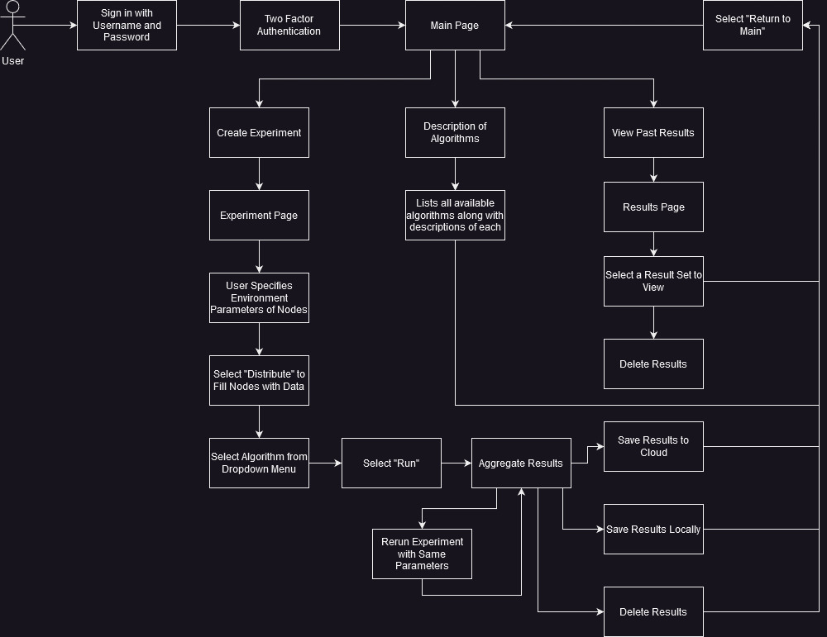
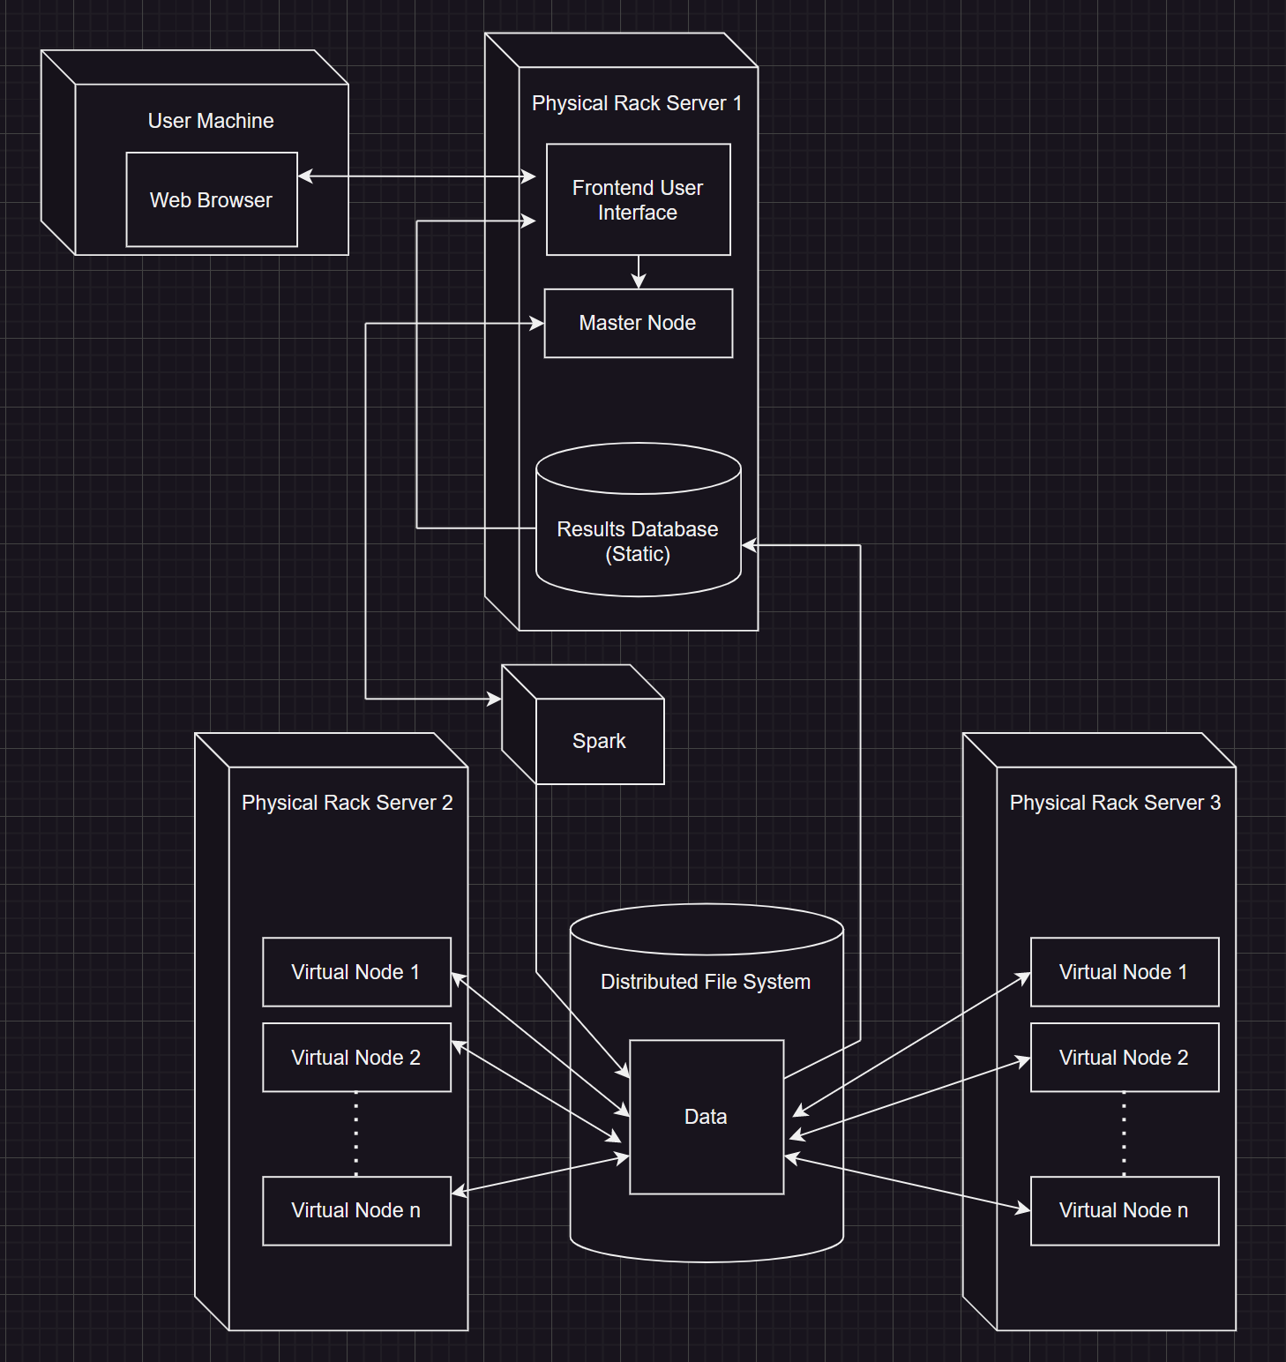
The PICARD
Abdalrahman Afifi, Hunter Lavender, Travis Mueller, Zachary Wildasin, Dr Thomas Devine
What is PICARD?
Functional Requirements
Engineering Requirements
Hardware
Platform for Intelligent Computer Algorithm Research and Development.
PICARD was developed to set up a distributed system and conduct machine learning research.
Each test the user will specify:
Which data sets and algorithms to use.
The number of systems running for the test.
Hardware parameters.
Hardware specifications for each individual node.
Create the Fullstack for the PICARD.
Have user authentication using two factor authentication.
Make sure the website is using the HTTPS protocol for security.
Be able to create nodes.
Be able to delete nodes.
Be able to create jobs through a UI instead of command line.
Set up a distributed system with user-defined nodes and resources.
Distribute test data, select and run an algorithm on the simulated system using user-defined parameters, and aggregate and visualize the results.
Compare results from multiple nodes.
Efficient and secure software that meets WVU and OPENSCAP standards, with secure nodes for client data confidentiality.
Maintainable software with thorough documentation for future updates and expansion.
Server:
Linux Based Server.
2 Intel Xeon gold 5218 processors.
Docker.
Nodes:
Ubuntu based linux operating system.
Apache Spark for distributed data.
processing.
Challenges
Conclusion and Future Work
Implementing an intuitive Graphical User Interface.
Finding balance between normalization and denormalization.
Which ensures optimal performance and data integrity.
Create scalable systems that grant future researchers flexibility when using the PICARD.
Ensuring complete system security for the lifetime of the PICARD.
Full functionality of the user interface along with deployment.
User interface is secure and friendly.
No major security vulnerabilities.
Install additional hardware
Free and open source software.
Secure and user friendly systems.
Guarantee smooth execution of experiments with accurate results.
Significant completion of user interface upon deployment.
Add more hardware to the servers that are already setup.
21 April 2023 West Virginia University Engineering Expo
Notes:
Click new slide in the menu bar then select template of choice for title slide and title/text slide formats. You can choose from various colors and textured backgrounds. Displayed is suggested font size and color.

